Slide 1
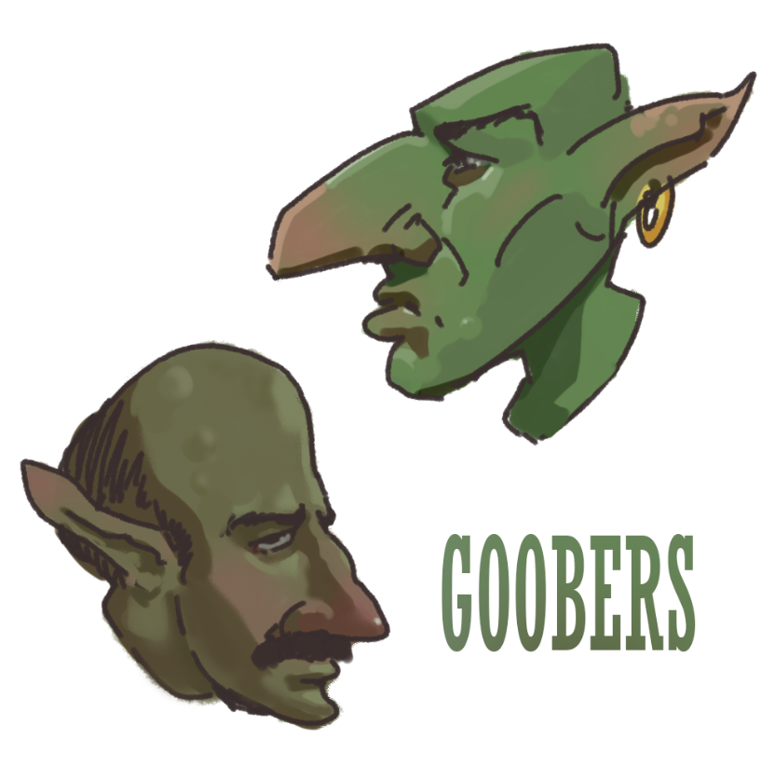
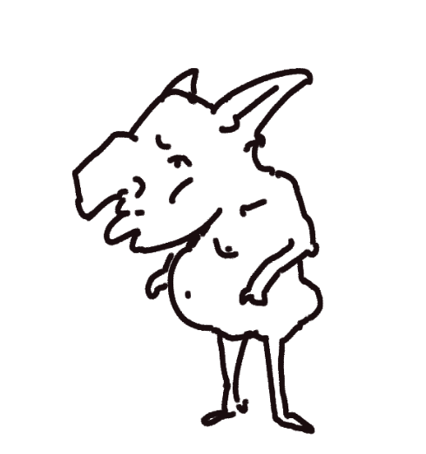
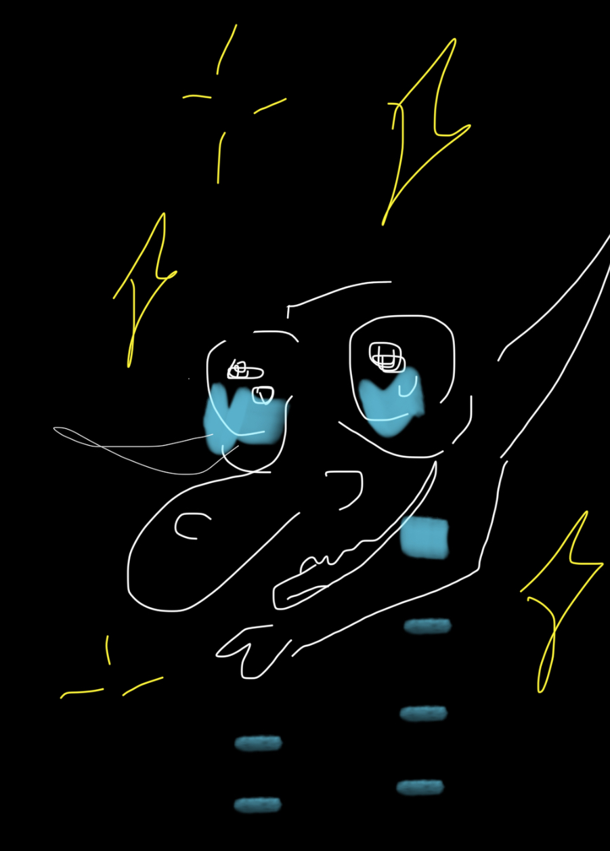
Cave goobers
Notes:
tuna

Slide 2
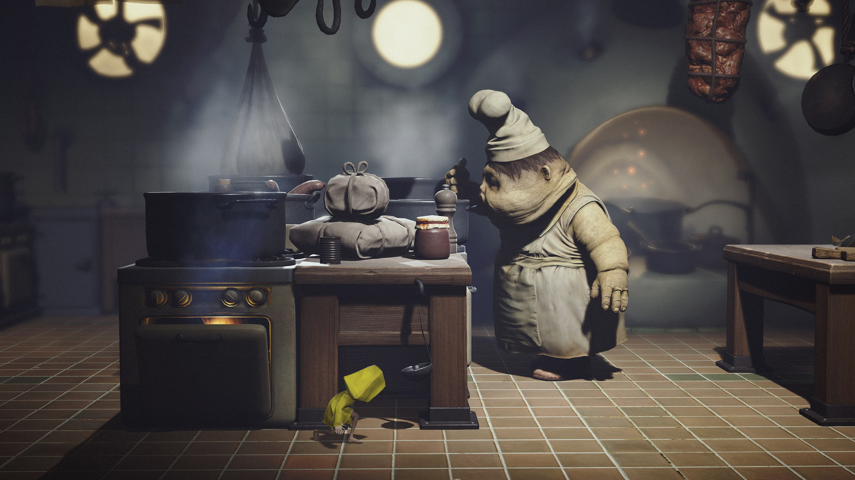
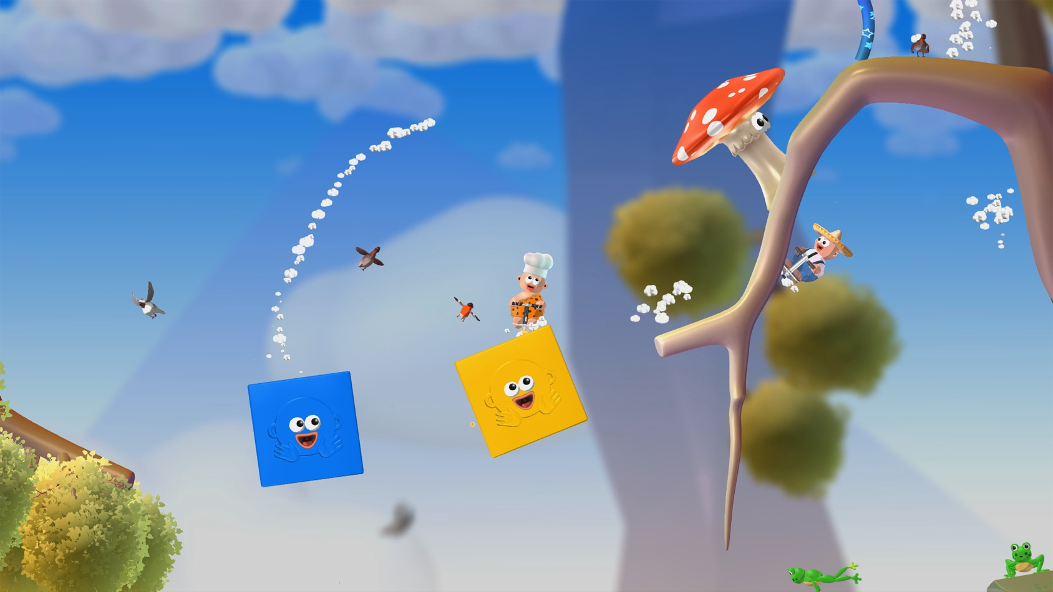
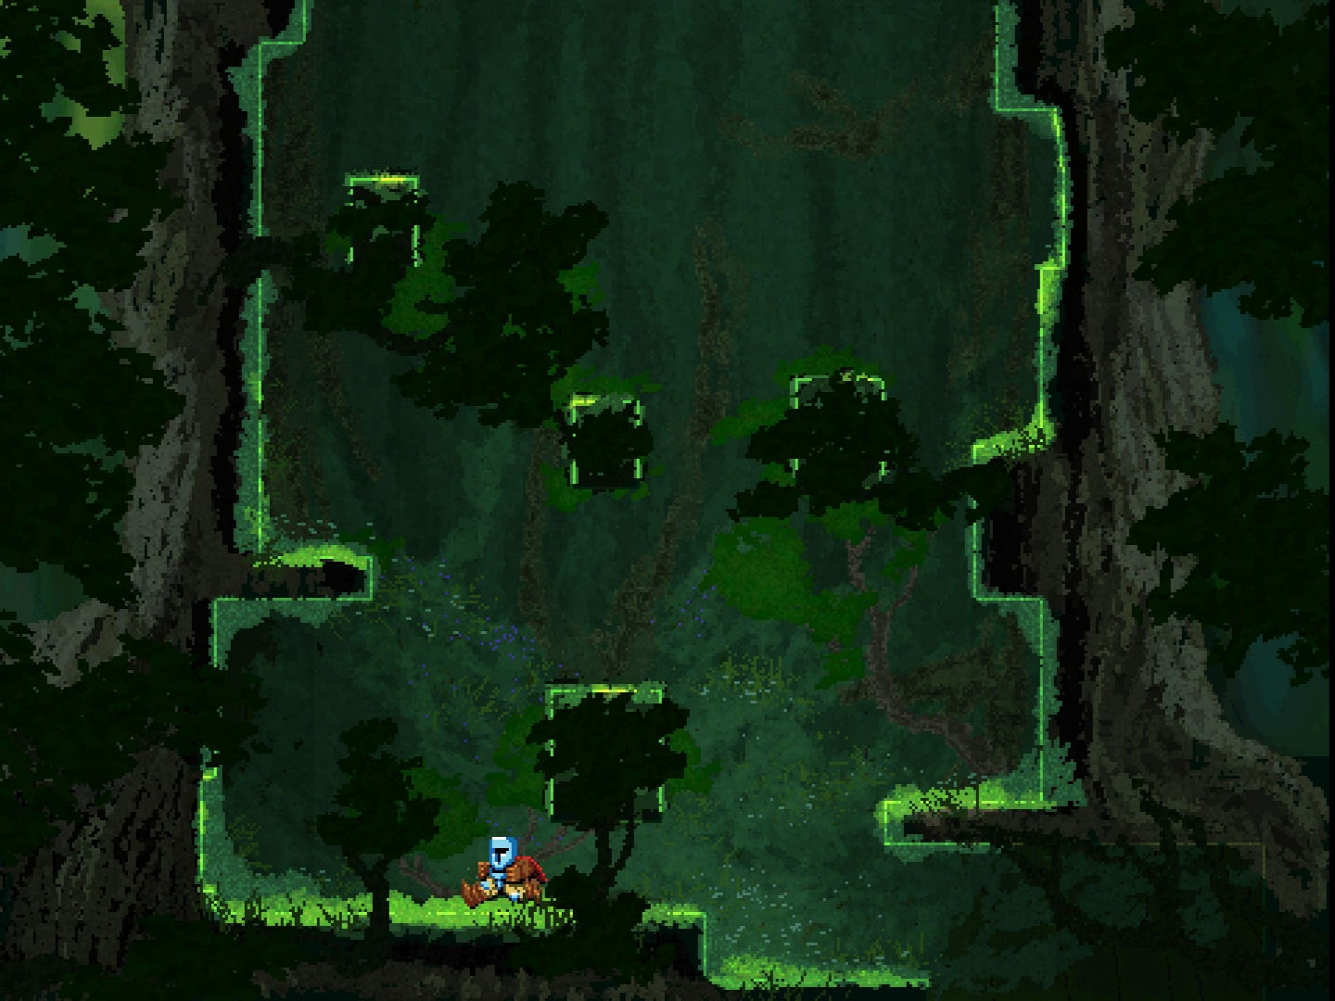
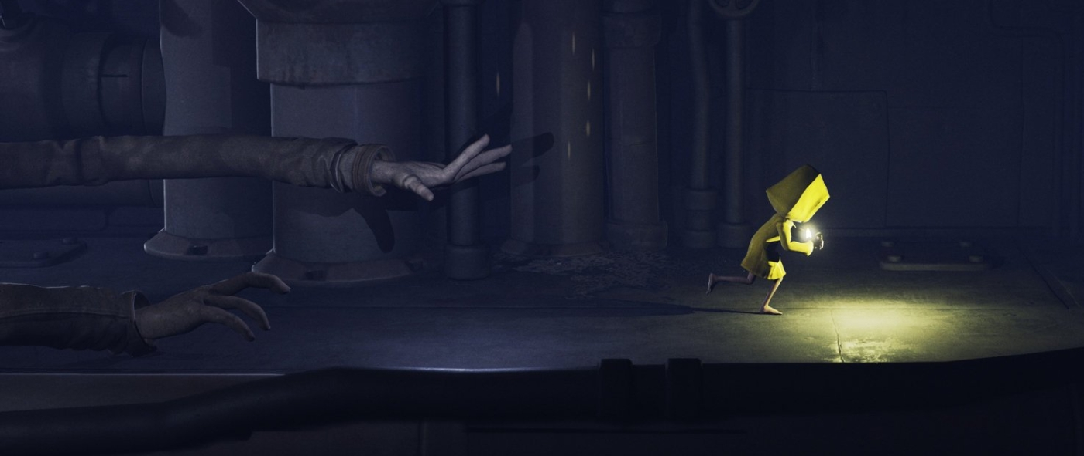
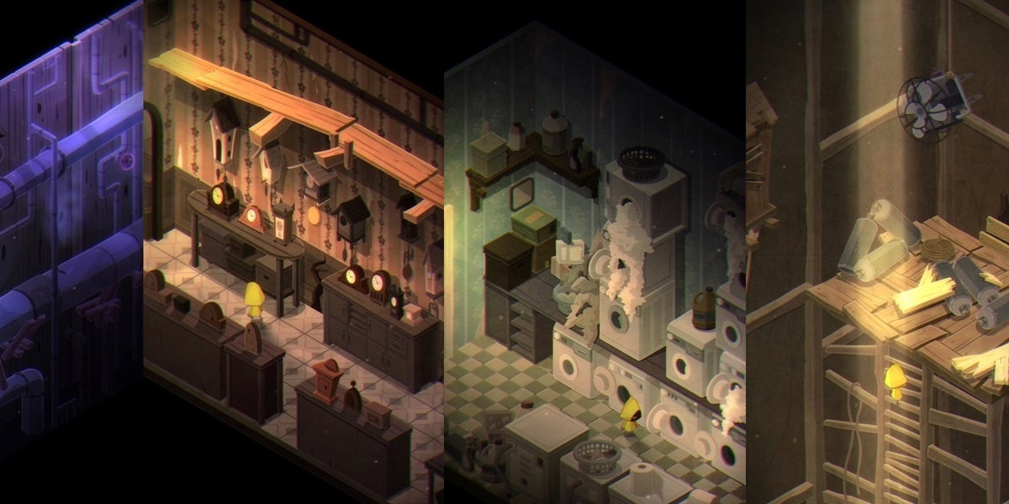
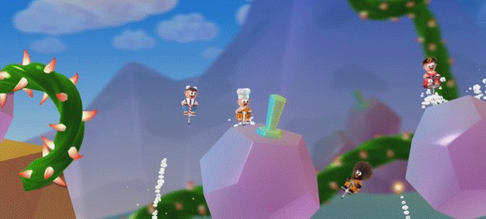
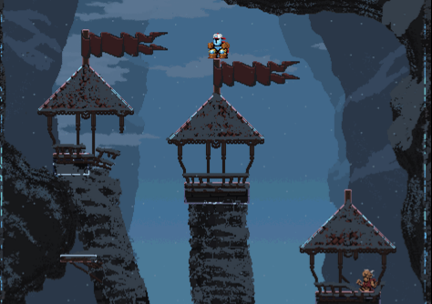
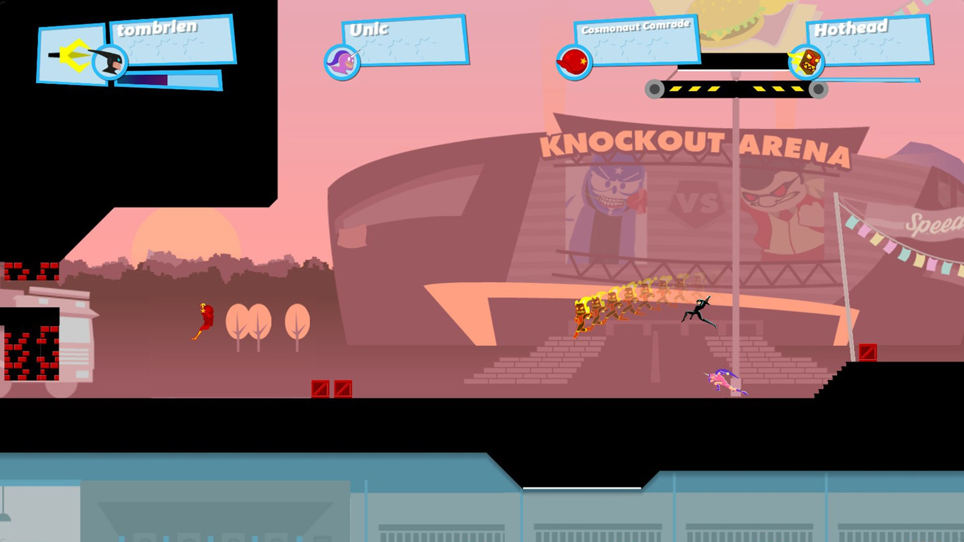
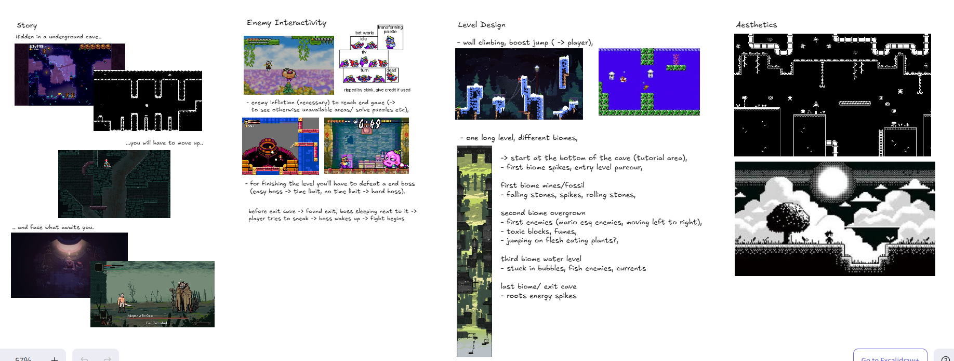
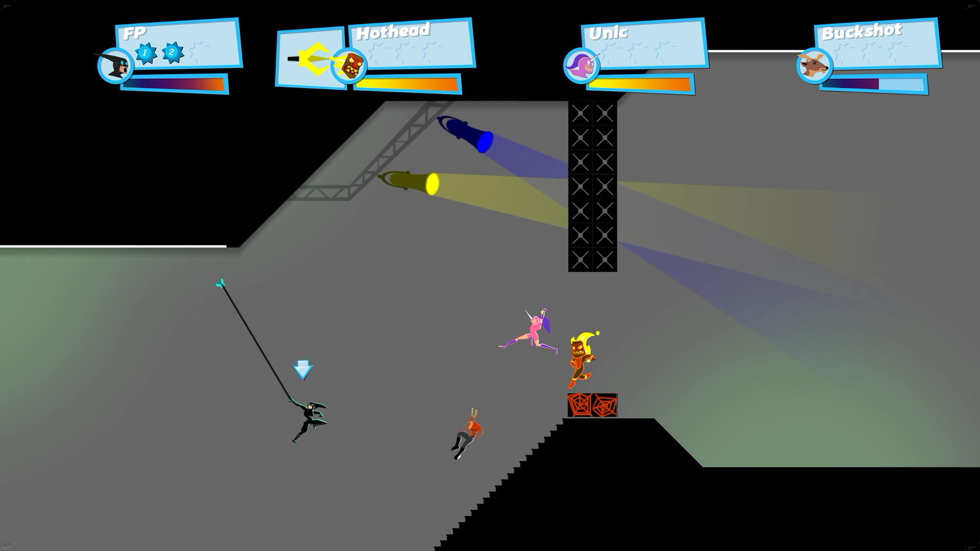
Intro (moodboard/inspiratie)
Notes:
Asia, max, tuna

Slide 3
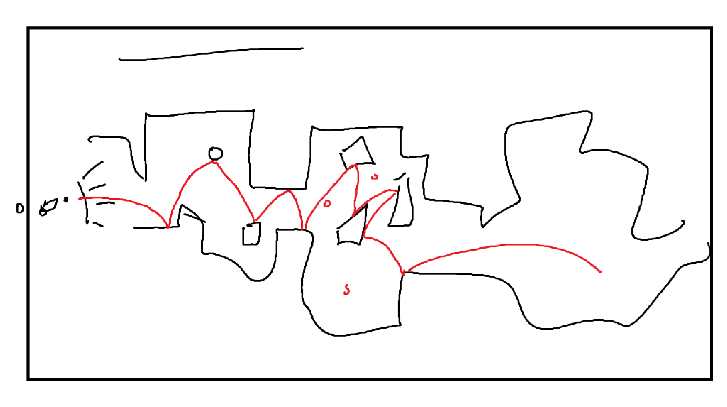


Intro: storyline
Trying to hide from [...] you ran into a cave and fell into the deepest part.
To survive there is no other option but to face your fears and work your way to the exit. But the thing you’ve hidden from hasn’t been forgotten and is awaiting you on the top.
Notes:
asia

Slide 4
Intro: objective/outcome
- You will have to face your fears and defeat the boss. - Start underground in a cave,
- Climb your way up through different biomes and enemies,
- Fight your way up to the exit of the cave,
- And defeat the boss that awaits you
Notes:
tuna

Slide 5
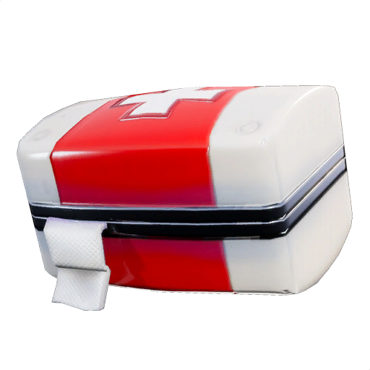
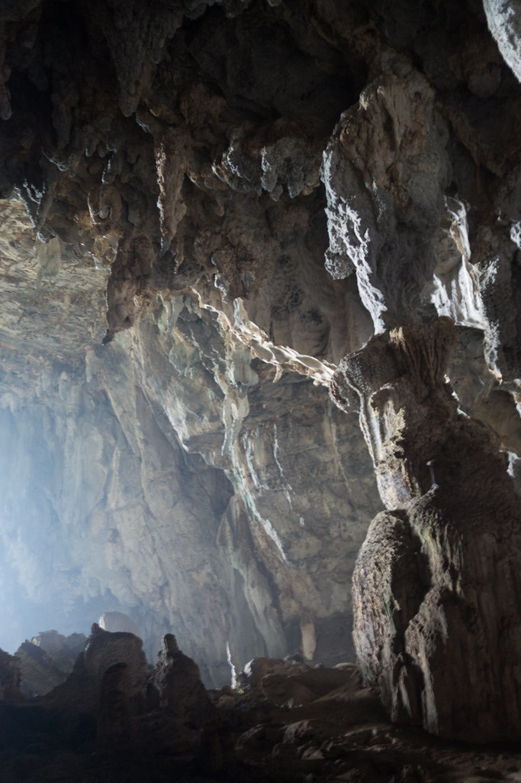
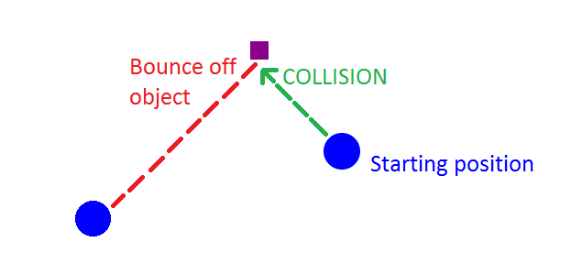
Formal elements
- Player
-Singleplayer
-role, hero of their story
-Objectives
- reach the top
- kill boss
- dont fall down
- put down a quick time
-Procedures
- jumping
-Rules
- max jump height
- walls bounce
-Resources
- collectable health items to use during a boss fight
-Conflicts
- enemies/boss
- biome effects
- yourself
-Boundaries
- edge canvas
- cave walls
-Outcome
- Falling down
- Kill boss = win
Notes:
max

Slide 6

Statement
Hear me out: play the game
Notes:
max

